Slide 1
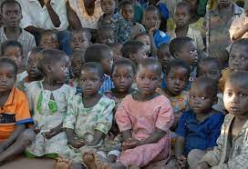
Database Management Systems ORPHANAGE MANAGEMENT SYSTEM
By
C VAISHNAVI(2110030096)
P PRANEETHA(2110030099)
S SAI NIKHITHA (2110030098)
G VAMSHI(2110030370)
Under the guidance of
SUMIT HAZRA

Slide 2
Problem statement and domain
As orphanages has been little in old style practice it lead to managing orphanage system in manual way which is storing information in notebook or registers.
People need to store not one two columns of information they need different sets for storing different sectors of information.
As there are many systems to manage the orphanage like students entry , adoption , supplies information, and many more .
All this managing is not been easy as they may lead to lot of confusion.

Slide 3
Existing solutions/ Naïve solutions
Creating an application for managing the number of orphans, their names, personal habits, activities, their original parents, health conditions, etc. details.
The app should be able to successfully manage the entire process with adequate information.
We would make the app with all the necessity elements to run the orphanage smoothly .
With this maintaining the records of the orphanage will be made easy to handle and access by the officials.

Slide 4
Proposed Algorithm Design Technique
The management system is been following a method of storing all the wear abouts of all the entries carefully .
It will enhance timeliness, accuracy, reliability and above all easy access to data and information.
The system will help to reduce the high rate of labour using to its high level of automation and independency

Slide 5
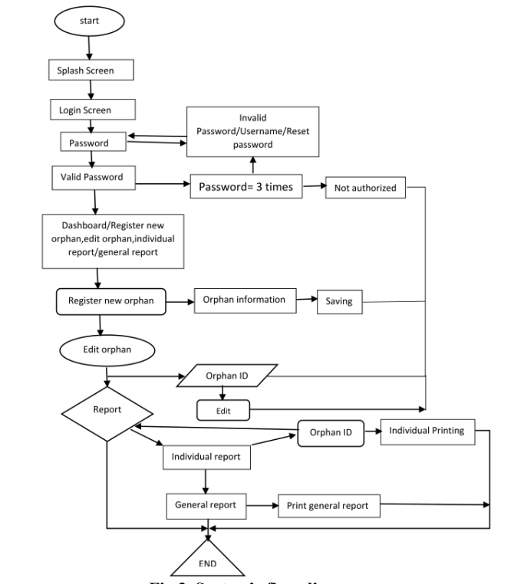
Flowchart Diagram

Slide 6
Data Structures needed
TREES
ARRAYS
STACKS AND QUEUES
FILES
STRINGS
RECURSION

Slide 7
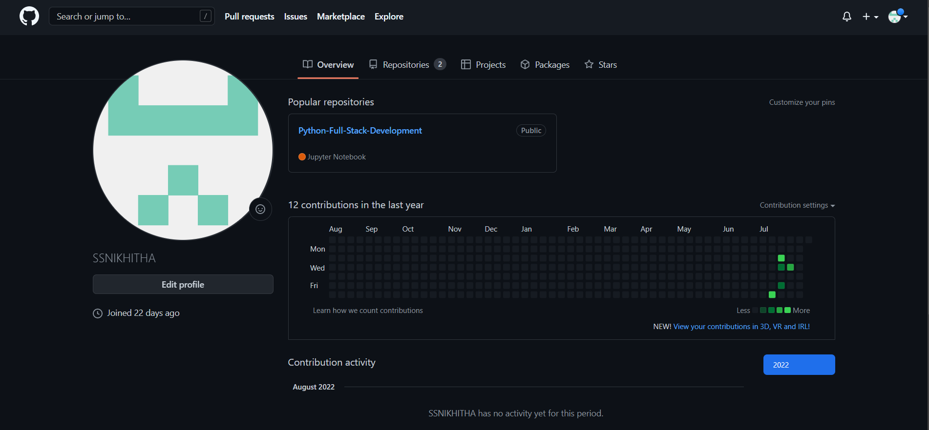
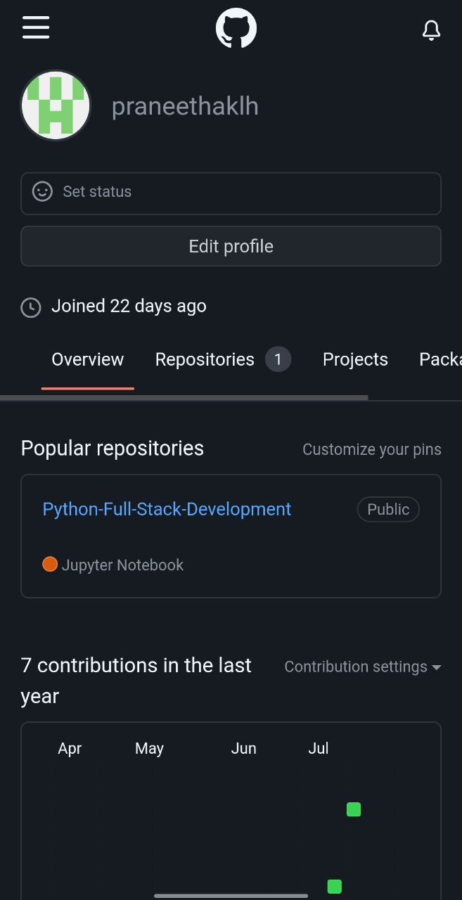
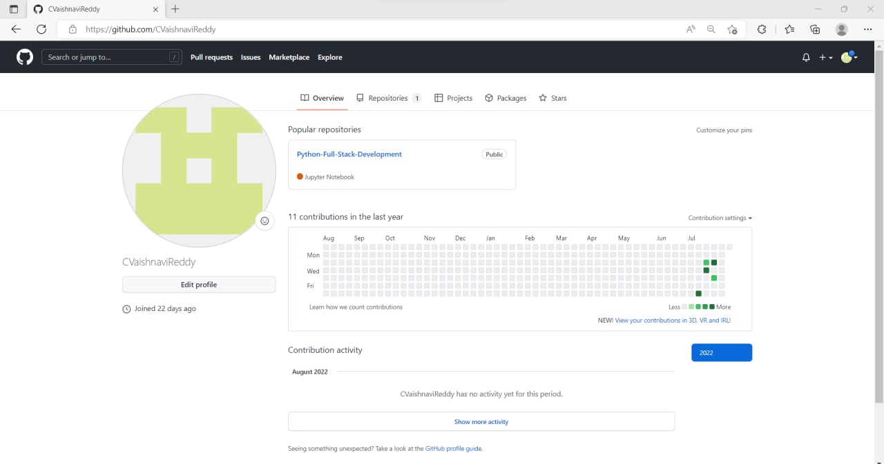
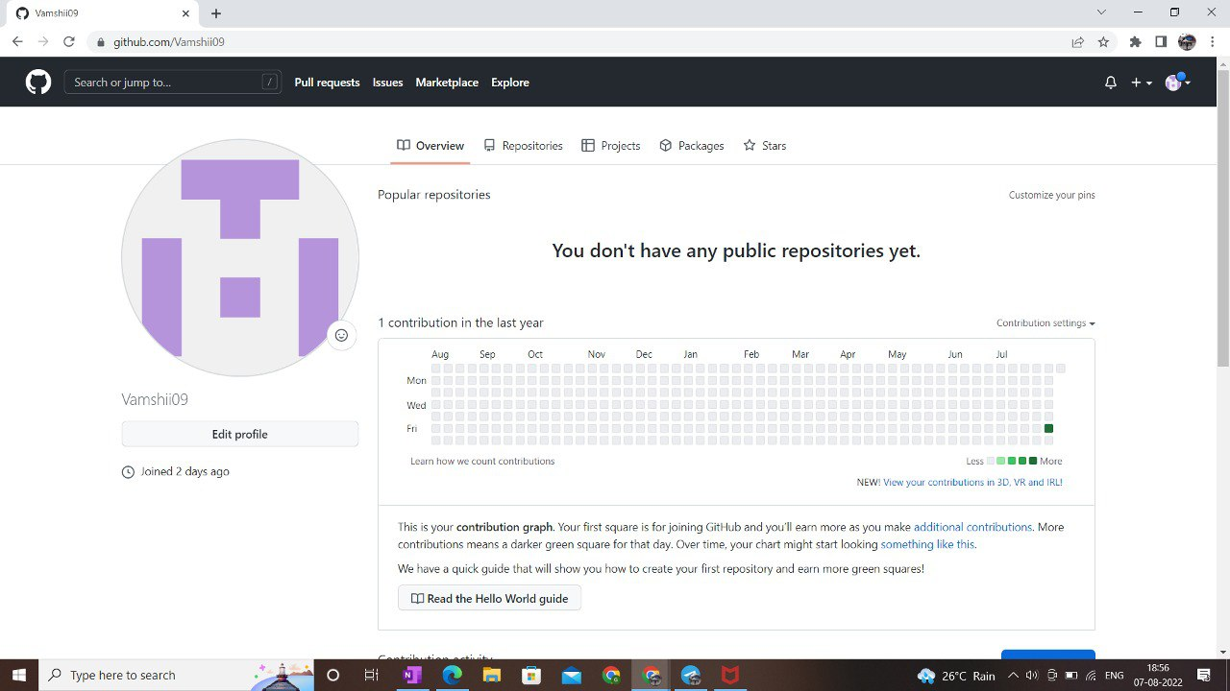
GitHub setup

Slide 8
Division of work among the group members
S SAI NIKHITHA – solutions
P PRANEETHA – algorithms and design techniques
C VAISHNAVI- problem domain
G VAMSHI- research on previous solutions

Slide 9

THANK YOU

